Slide 1

Music Recommendation System
Prepared By:
PARVEJ ALAM MAHAMMADDIN ANSARI
Intern ID: SMI65929

Slide 2
Music Recommender System
Why Recommender Systems ?
How to build a Recommender System ?
a. Popularity Based Filtering
b. Content Based Filtering (Classification Based)
c. Collaborative Based Filtering
i. Nearest Neighbor
ii. Matrix factorization
3. About K-Means Clustering
4. Dataset Information
5. Collaborative Recommendation System
6. Content-based Recommendation System
7. Conclusion

Slide 3

1. Why Recommender Systems ?
Personalized Experience: A recommender system makes prediction that are tailored and specific to a user
Customer Satisfaction: Users are left satisfied as they do not need to spend time searching for what they might like as the system does it for them
Discovery: Users can discover new items that are similar to their taste, making it an engaging experience
Increased Profit: Users then to spend more time on sites that make adequate prediction of what they might like or want, which could translate to spending more money on purchases.
Business Analysis: A recommender system make it easy for a business to analysis its customer behaviour and put up product that their customers want.

Slide 4
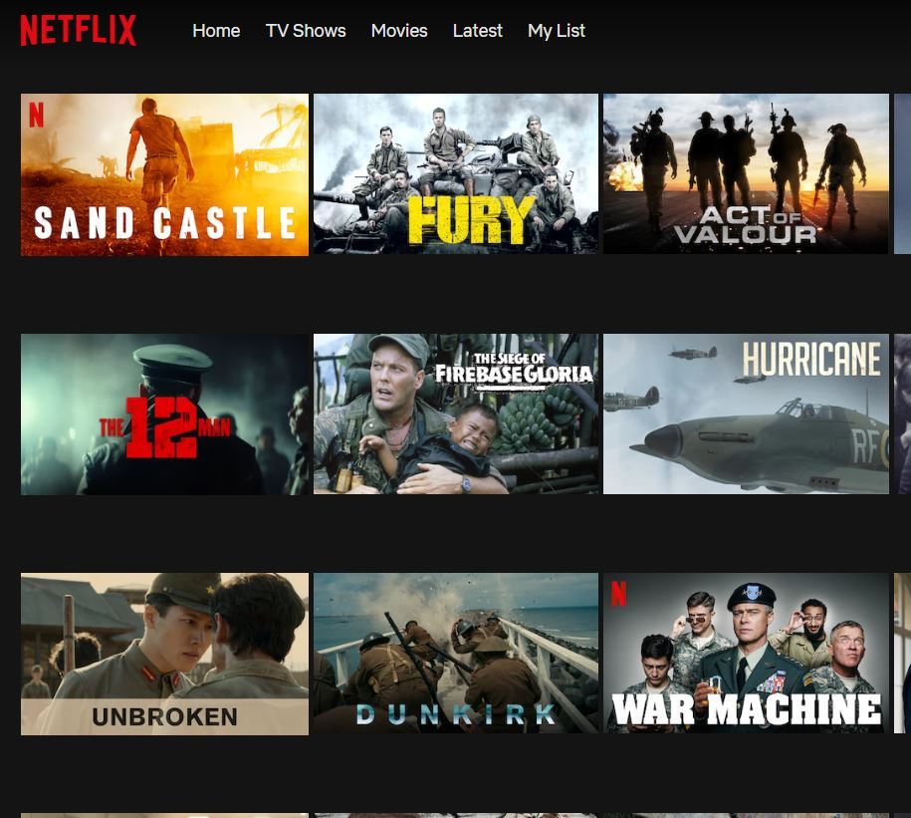

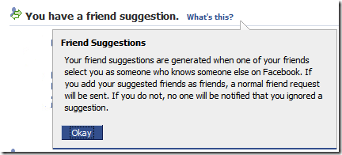

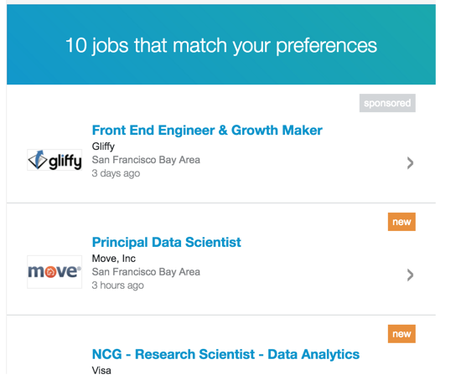
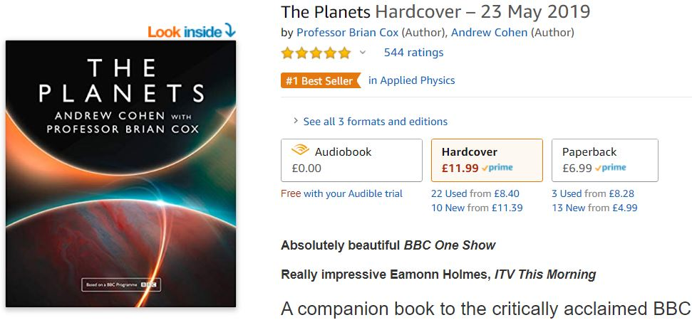
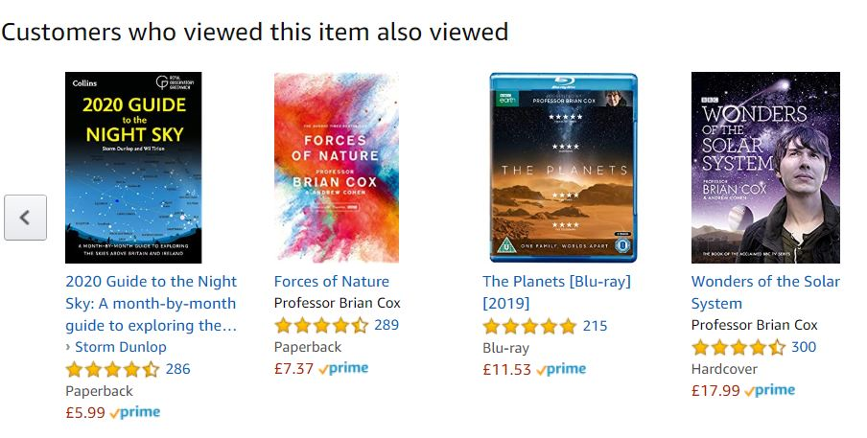
Examples : Movie/TV show Recommendations,
Friend Recommendations,
Job Recommendations, Product Recommendations

Slide 5



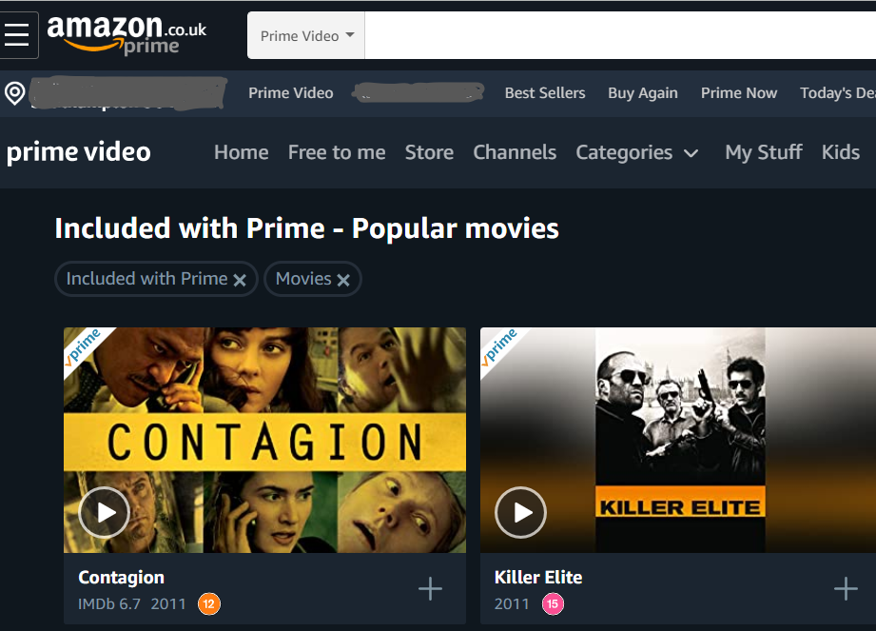
Building a Recommender System
a. Popularity Based Recommender System
b. Content Based Filtering
a. Popularity Based Recommender System : Recommend Items viewed/purchased by most people, Recommender ranks list of items by their purchase count
b. Content Based Filtering: Use features of both products and users in order to predict whether a user will like a product or not.
User Features
Eg: Age, Gender
Product Features
Eg: Cost, Quality
Purchase History
Classifier
Like/not like
Limitations:
1. It is difficult to collect high quality information about products and users.

Slide 6
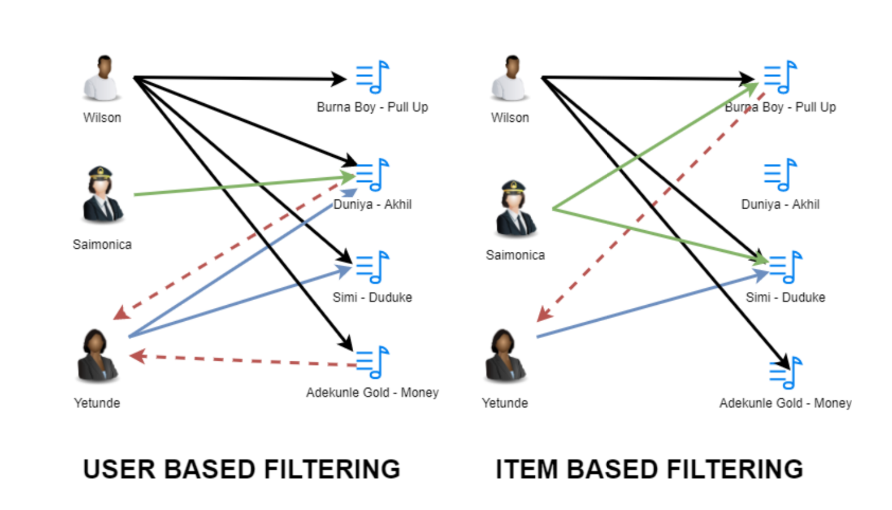
c. Nearest Neighbor Collaborative Filtering
User-based Collaborative Filtering
Item - Based Collaborative Filtering
Find users who have a similar taste of songs as the current user .
Similarity is based upon similarity in user’s listening mood.
Eg: “User A is similar to user B because both listened items are X,Y and Z.”
Recommend songs that are similar to the songs the user listened to.
Similarity is based upon co-occurrence of songs.
Eg: “Songs A and B were listened by both users
X and Y, so they are similar.”

Slide 7

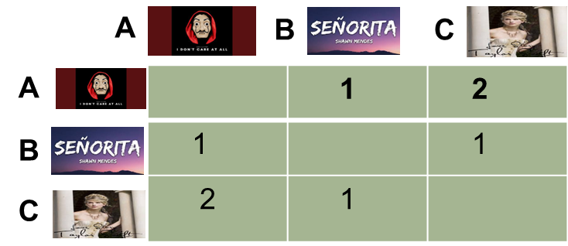






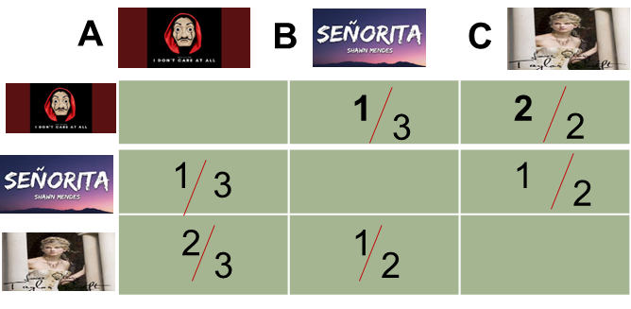
Item-Based Collaborative Filtering:
An Example (People who listened A this also listened C )
History Matrix
Co-occurrence Matrix items by items
B
A
C
Yetunde
A
C
Monica
A
?
Wilson
Effect of Popular songs : Example, if everybody has listened to X song, then it is not a very good indicator of what to recommend next, the recommender would become similar to a popularity based recommender engine.
Normalize Co-occurrence Matrix : Normalize by popularity , number of users common for I and j and number of users for either I and j.
Effect of Multiple Items : Weighted sum , Ranked Recommendations
x
A
10,000
B
10002
C

Slide 8
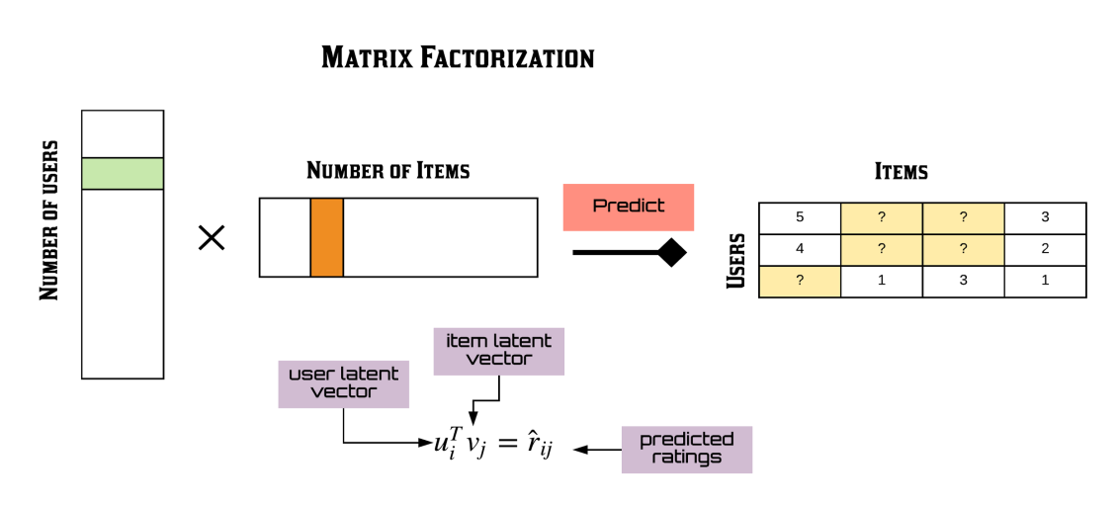
Model Based Collaborative Filtering (Matrix Factorization Method)
Identity latent(hidden) features from the input user X song Ratings Matrix to represent users and songs as vectors in N dimensional space.
(Serious/Escapist?) Geared towards Males or Females?
User Vector (u) = [1.3 2.8]
Item Vector (v) = [2.5 -1.9]
New user (Known ratings): [4 5 ….3]
Training: Use Matrix Factorization approaches (eg. Singular Value Decomposition (SVD)) to split the Rating Matrix into constituent User Matrix and Item Matrix with minimum (Sum is squared error (SSE)).
Goal : Predict unknown ratings for the remaining set of songs using the learned User Matrix and Item Matrix

Slide 9
SOME IMPORTANT POINTS :
Popularity Based recommender system can use purchase history and its scalable.
Content Based (Classification Model) Recommender System
a. Can generate the Personalized Recommendations
b. Can use User and Item Features
C. Can use the purchase History and it is not scalable
User X item Ratings sparse matrix(any huge data), example: size 480,189 X 17,770 –. Model Based Collaborative Filtering (MATRIX FACTORIZATION) method used.
Which model can handle the brand new items ??
 | Popularity Based | Content Based | (Nearest Neighbor-based CF) | (Matrix Factorization based CF)
Personalized Recommendations |  | YES | YES | YES
Uses Context (Eg. time of day) | YES | YES
User Features |  | YES |  | YES
Item Features |  | YES |  | YES
Can handle brand new Items? | NO | YES | NO | YES
Purchase History |  | YES | YES | YES
Scalable | YES | NO |  | YES
COMPARISION OF RECOMMENDATION SYSTEMS

Slide 10
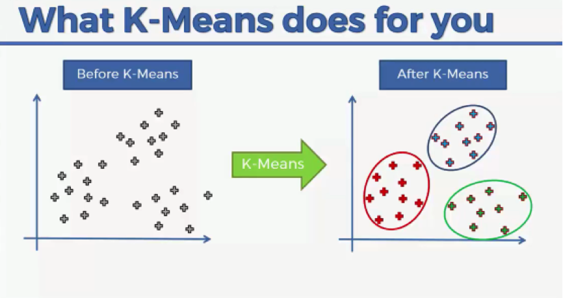
3. About K-Means Clustering
Clustering is the process of dividing the datasets into groups, consisting of similar data-points and its main aim is to group similar elements or group points into a cluster.
Clustering is unsupervised learning – It will have unknown number of classes , no prior knowledge and finds the natural groupings between objects.
Clustering methods are basically used to automatically group the retrieved documents into a list of meaningful categories
K-MEANS in Recommendation Systems:
K-Means clustering was implemented by creating a cluster of songs in the dataset. Based on the cluster, recommendation was then made. One of the advantages of this method is that it scales well with very large dataset.

Slide 11
4. Dataset Information
We are going to use the Million Song Dataset, a freely-available collection of audio features and metadata for a million contemporary popular music tracks.
There are two files that will be interesting for us. The first of them will give us information about the songs. Particularly, it contains the user ID, song ID and the listen count. On the other hand, the second file will contain song ID, title of that song, release, artist name and year. We need to merge these two DataFrames. For that aim, we'll use the song_ID
Dataset Links:
https://static.turi.com/datasets/millionsong/10000.txt
https://static.turi.com/datasets/millionsong/song_data.csv

Slide 12
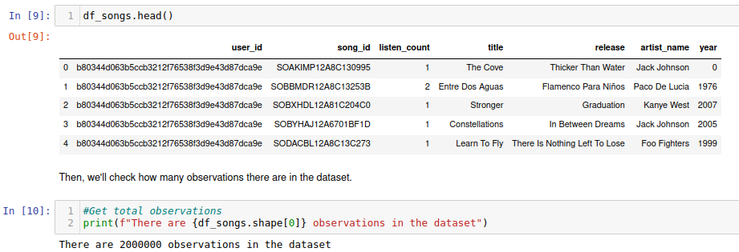
5. Collaborative Recommendation System
Basic Exploratory Data Analysis

Slide 13
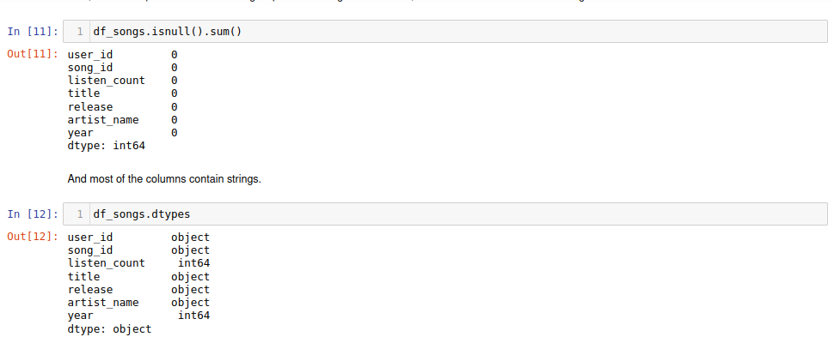
continue…
Basic Exploratory Data Analysis (Continue..)

Slide 14
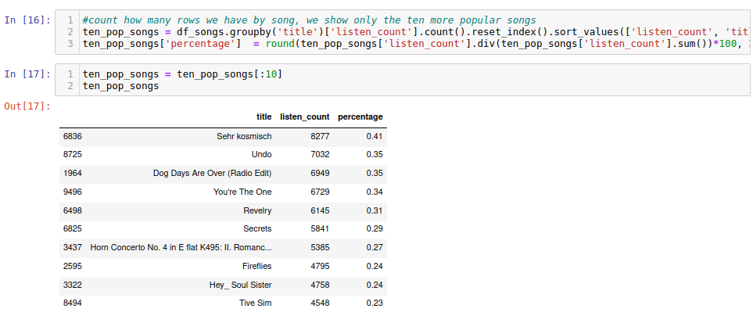
continue…
Most popular songs

Slide 15
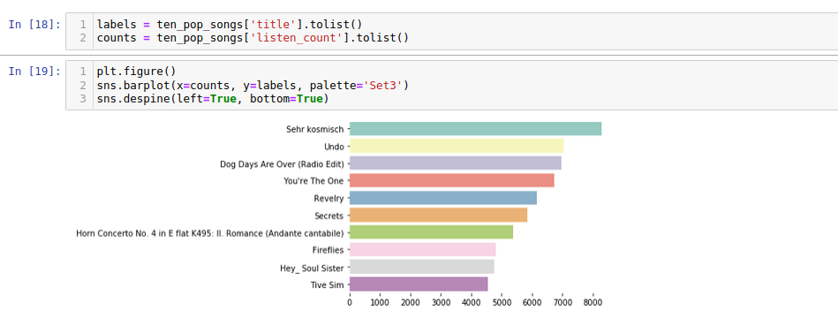
continue…
Most popular songs

Slide 16
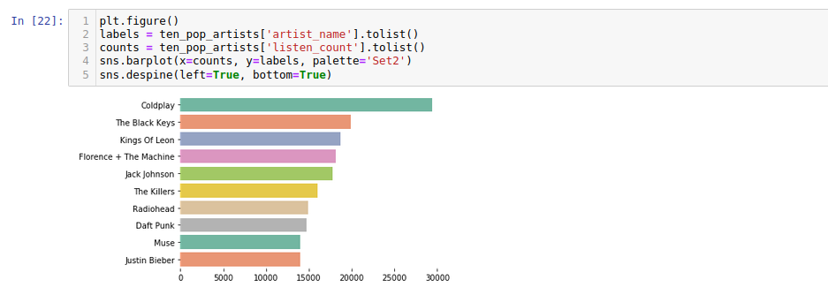
continue…
Most popular artists

Slide 17
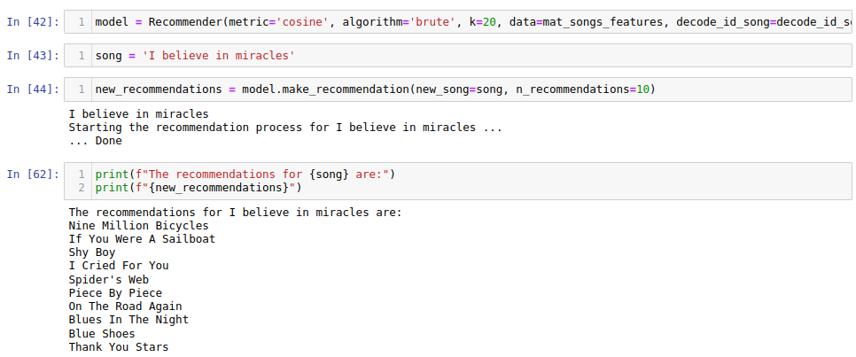
continue…
Model and Recommendations

Slide 18
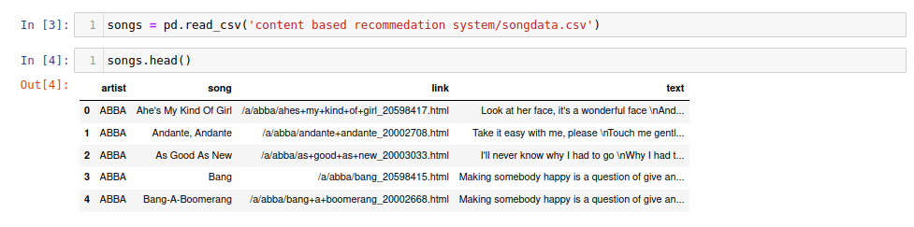
6. Content-based Recommendation System
Basic Exploratory Data Analysis

Slide 19
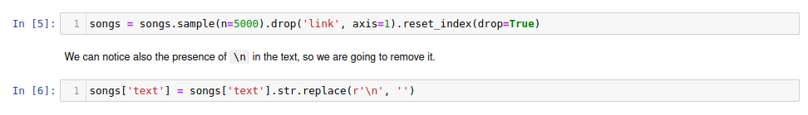
continue…
Data Selection and Data Cleaning

Slide 20
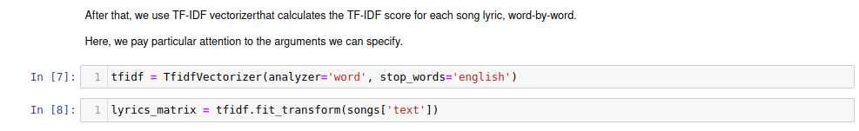
continue…
TF-IDF Vectorization Technique (Word to Vector Conversion)

Slide 21
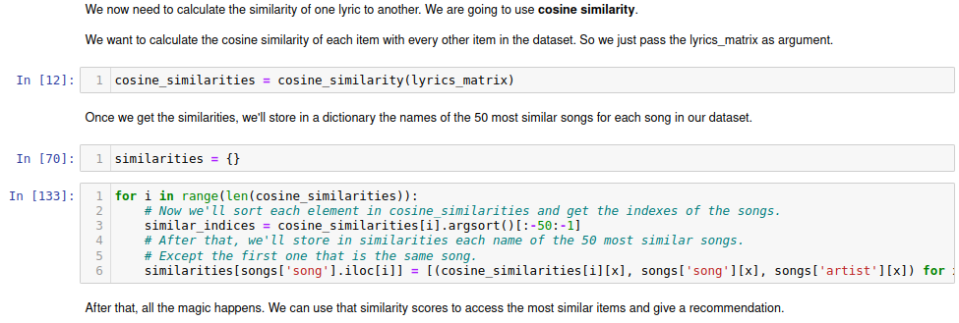
continue…
Applying Concept of Cosine Similarity

Slide 22
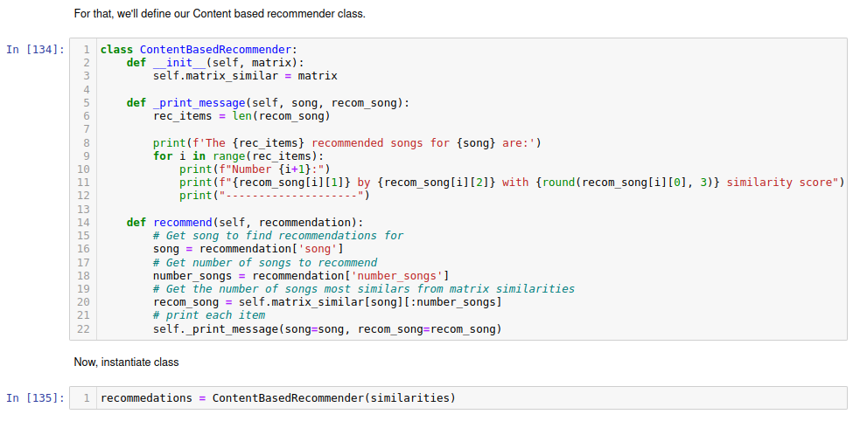
continue…
Creating Recommendation Class

Slide 23
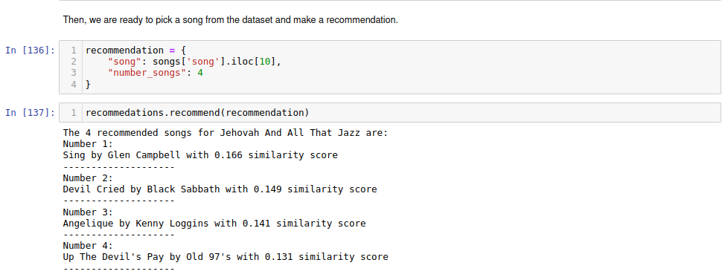
continue…
Use Case: 01_ Recommending Song

Slide 24
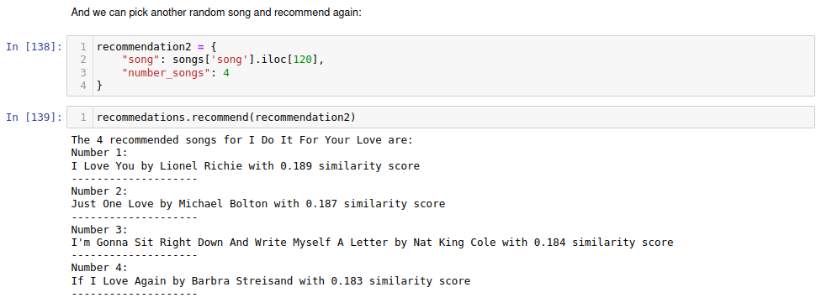
continue…
Use Case: 02_ Recommending Song

Slide 25
7. Conclusion
Popularity-Based Model works in cases popularity of an items is only considered which is not suited for the type of recommender system.
Collaborative Filtering Model using Matrix Factorization gave a good result, it was able to make personalized recommendations, which is better suited for our model.
KMeans- Clustering Model can also be explored as an alternative to building a recommender system, as the built model was able to cluster songs based on listen_count.

Slide 26
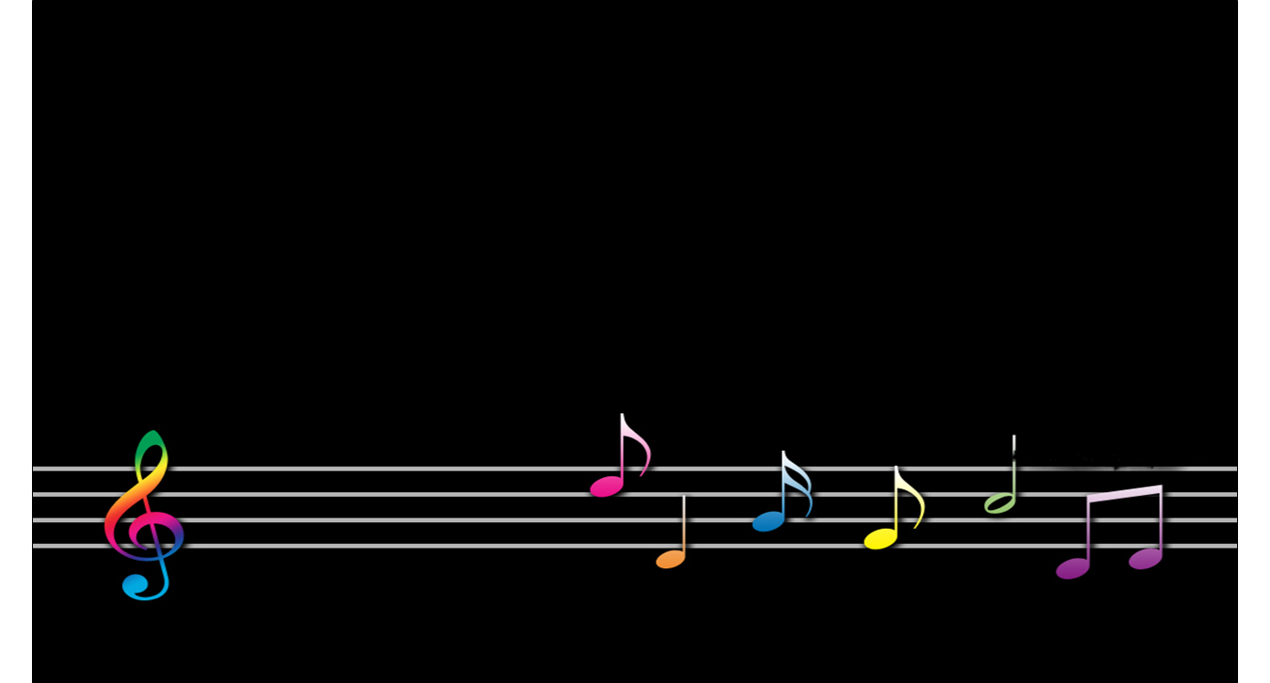
THANK YOU

